Slide 1
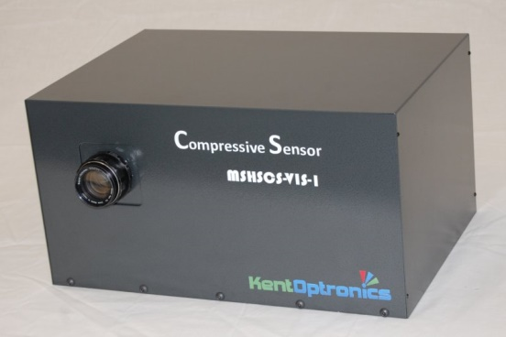
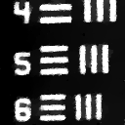

Multi-Mission Compressive Sensor
The Multi-Mission Compressive Sensor is a Compressive Multispectral (MS) and Hyperspectral (HS) Foveal Video Sensor (CMHFVS) developed under the strategic partnership with Prof. Kevin Kelly in Rice University. It is a unique state-of-the-art computational imaging system that combines both optical and computational elements with real-time adaptive configurability to address user’s needs in challenging multiple-threat and multiple-mission environment. It provides real-time “Adaptive Configurability” such that the sensor hardware and software allows adaptation of sensing/perception parameters like spatial, temporal, spectral resolution, field of view and processing latency in real-time on-the-fly. It enables “Multi-Mission” via the adaptive configurability with the capability to conduct more than just one mission in a manner similar to the human visual system, i.e., detection-of-x, identification-of-y, tracking-of-z, over-watch, and situational awareness. It is a vital tool for instantaneous target detection & recognition relying on a few frames of direct HS CS measurements.
The offered sensor is implemented with both a single pixel detector path for high sensitivity and fast frame rate grayscale imaging; and a spectrometer path for HS imaging. Both paths share a common objective lens and programmable DMD aperture for 2-D spatial coding. The implemented software executes data acquisition, reconstruction for real-time coarse resolution video preview, and reconstruction for fine resolution.
The sensor enables:
Flexible selection between MS and HS sensing modes;
Fast sampling rate for target identification;
Flexible fovea with arbitrary region of interest (ROI) number, size, location, and resolution in both spectral and spatial domains;
Compact size, weight, and power consumption plus cost (SWaP-C).
The offered sensor can be used as a scientific research backbone platform for facilitating advanced Compressed Sensing, Machine Vision, Deep Learning research, and also a good education platform for college students to study in the field of artificial intelligence (AI).
The CMHFVS comes with a complete hardware package with the software for data acquisition, reconstruction and display.
Ground Truth Video
(Press “F5” to watch the video)
Foveate Over Path
6.67% - 16/128 Foveated Reconstructed Video
Contact Info:
Le Li, CEO
Tel: (845)897-0138
Fax: (845)897-0603
Email: leli@kentoptronics.com
www.kentoptronics.com

Slide 2
Compressive Multispectral and Hyperspectral Foveal Video Sensor (CMHFVS)
The CMHFVS sensor captured scene, where (A) Image captured by the conventional 2-D camera inside the CMHS, (B) Reconstructed grayscale image from the single pixel detector; and (C) Reconstructed color image from the spectrometer based on CIE 1931 color space
Selected hyperspectral image frames at different wavelengths which have been reconstructed with a spectral resolution Δλ = 10 nm of the scene in the above figure
a-TreMTM Specifications
Visible CMHFVS Specifications
Parameter | Value
Spectrum (nm) | 400 - 850^{(a)}
Spatial resolution | 1×1 to 1024×1024^{(b)}
Spectral resolution (nm) | 0.8 - 450 nm
Frame rate (fps) | 30^{(c)}
Field of view (deg) | Up to 12 × 12
Size (Inch)^{(d)} | 12" × 9.5" ×18"
Weight (Lb)^{(d)} | ~24
Power consumption (W) | ≤ 55
Notes:
^{(a)} --- Other spectra are available under special order, till 12 μm in long wave infrared (LWIR).
^{(b)} --- Compressed, not full resolution at 1024×1024
^{(c)} --- Compressed video rate
^{(d)} --- The weight and size specs are for generation-1 product, which can be reduced in the future

